Slide 1

UNIVERSITÀ DI PISA
SCUOLA DI INGEGNERIA
INTERNET OF THINGS
Depuration Air system Project
Ritorti Fabiana
A.A. 2019/2020

Slide 2
INTRODUCTION
This project is about the depuration air system based on sensors and actuators installed in some devices in an office or in a home.
These devices could interface with a cloud application that shows to the user the status of the devices and gives him the possibility to change their status.

Slide 3







CLOUD APPLICATION
BORDER ROUTER
DEVICE
DEVICE
COMMAND LINE INTERFACE
USER

Slide 4
SYSTEM COMPOSITION AND ITS FUNCTIONALITIES
Each device is composed by:
Quality sensor(res_quality) that collects data about the quality of the air.
Air actuator(res_air) that has the aim to switch ON/OFF the depurator.
All the nodes are managed by the border router.

Slide 5
SYSTEM COMPOSITION AND ITS FUNCTIONALITIES
The aim of the application is to verify if the quality of the air is bad or good; in the first case, the depurator is switched ON, in the second case the depurator is switched OFF. To verify if the quality is good or not I defined a threshold of 50 and, if the quality value is below this threshold the quality is bad instead if the quality value is above this threshold the quality is good.
If the depurator is switched ON the quality of the air improves instead if the depurator is switched OFF the quality of the air gets worse.

Slide 6
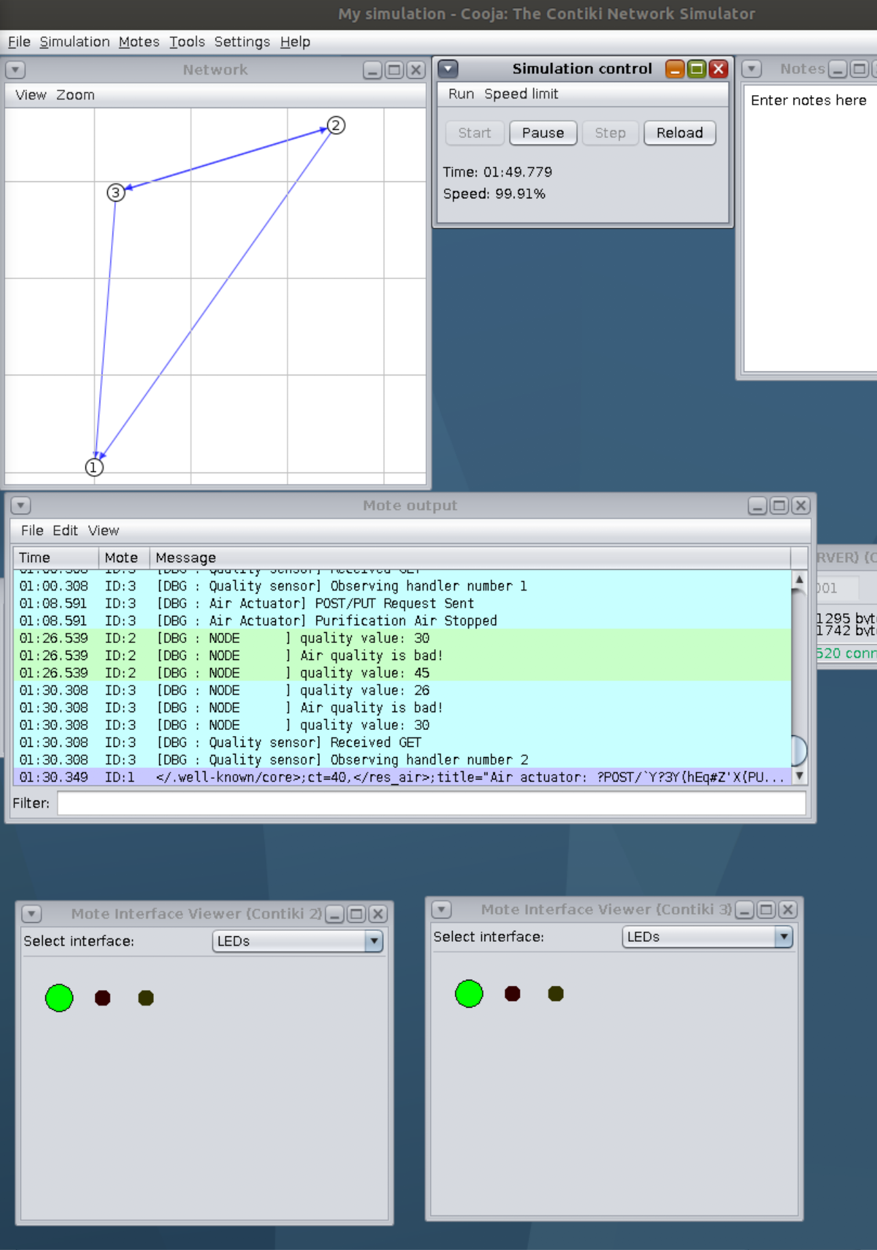
COOJA SIMULATOR
The user can check the status of the depurator on Cooja through the LED interface.
If the quality of the air is bad the depurator is ON and the LED is GREEN, instead if the quality of the air is good the depurator is OFF and the LED is RED.

Slide 7
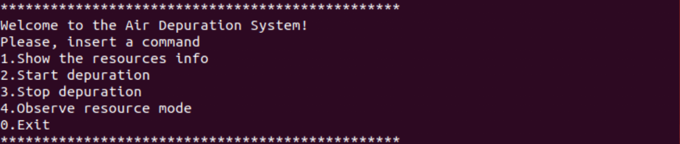
APPLICATION
The application has a command line interface that allows to the user to interact with the devices.

Slide 8
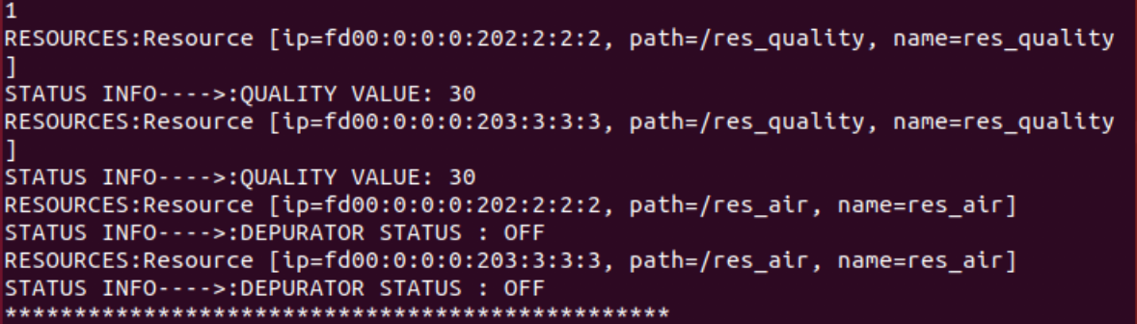
APPLICATION
After some time related to the registration phase,if the user insert the command ’1’ , he could check the initial status of the resources.

Slide 9
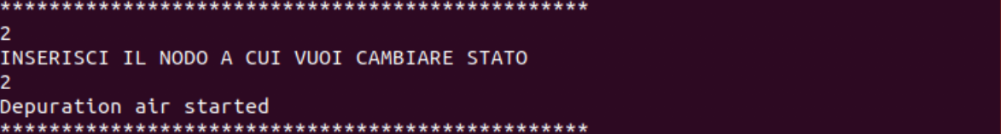
APPLICATION
If the user insert the command ’2’ , he could switch ON the depurator of the node, after insert the node at which he wants to change the status.

Slide 10
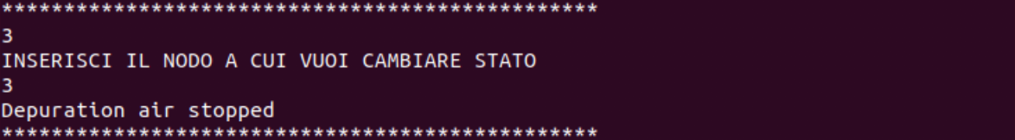
APPLICATION
If the user insert the command ’3’ , he could switch OFF the depurator of the node, after insert the node at which he wants to change the status.

Slide 11
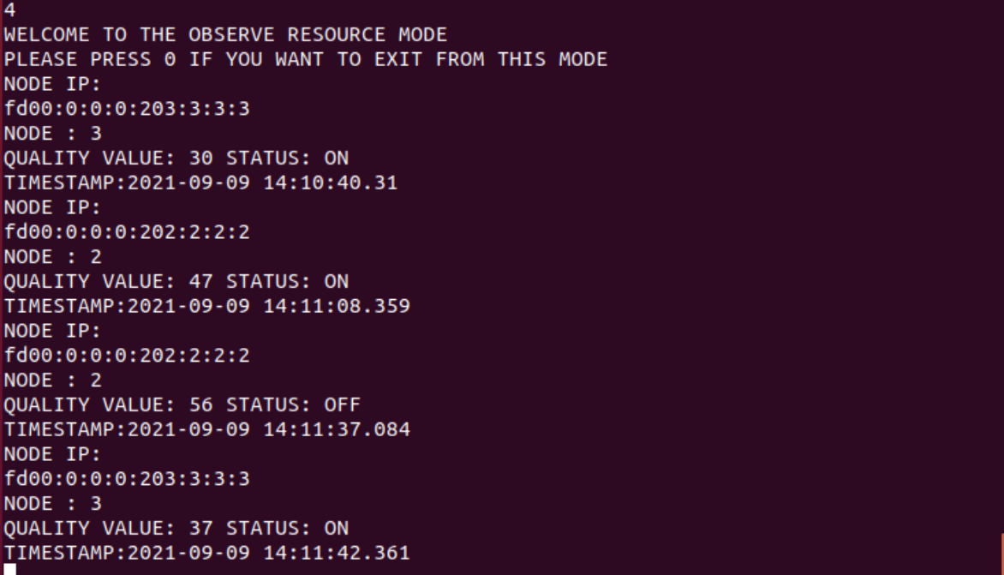
APPLICATION
If the user insert the command ’4’ , the user enter in the ‘observing mode ’ and he is updated about the current state of the resources and their changes. He could see also a timestamp corresponding to each update that arrives after 60 seconds and after every change in a state as trigger.

